Slide 1

COVID 19 INDIA DATA ANALYSIS
By:
Team 3B
PT DA 15 BATCH
Ankit, Ashish Kumar, Anivesh Singh,
Jagadeesh Vanarasi

Slide 2
INTRODUCTION
1
About
The main objective is to manipulate the data in way which can be read, analyze, and get some insights from it. Get the information from the data.
Data
2
Data has been taken from the official website of India govt.“covid19india.org”
Data is from Jan-2020 to Oct-2021.
Data was in JSON format
Columns : Delta, delta 7
Data Processing
3
We have used different types of tools on a raw data to process the data
Python –To Copy : Request, Converting – JSON, Filtering and Cleaning : pandas
Sql Server – For aggregation
MS Excel – To Presentation of data

Slide 3

1
Collection
Request module was used to
Get the data from the url.
HOW DATA
HAS
BEEN PROCESSED?
2
Conversion
JSON was used to converts the into python dictionary
REPORT
FORMAT
3
Dealing with NAN
pandas nodule was used
To find the NULL values
4
Cleaning
Finding % of rows having null for each column
Deletion of columns
5
Arranging the data for finding out the insights
9

Slide 4
FINDINGS
&
INSIGHTS

Slide 5
YEARLY TREND OF YEAR 2020 vs 2021
Trendline/Wave for both the year is almost Identical.
There is a lag of approximate 5 months in Year 2020 compare to year 2021.
The Volume in 2021 is more than 2020
Year 2020
Year 2021

Slide 6
TEST POSITIVITY RATIO vs NO OF TEST DONE
It can be seen that as number of test done increases the ratio of confirmed cases from test done also increases.
Test Positivity Ratio = (Delta 7 Confirmed / Delta 7 Tested) *100

Slide 7
EFFECT OF VACCINATION ON COVID
It can be seen there is a positive relation but density is low.
But lower number confirmed and deceased can also be because of Downward trend of covid for year 2021
by 31 oct 2021 only 25% people was fully vaccinated .

Slide 8
SPREAD OF COVID vs SEVERITY OF COVID
From data it shows severity was same for both years.
There were high deaths in 2021 because there were more cases as compare to Year 2020

Slide 9
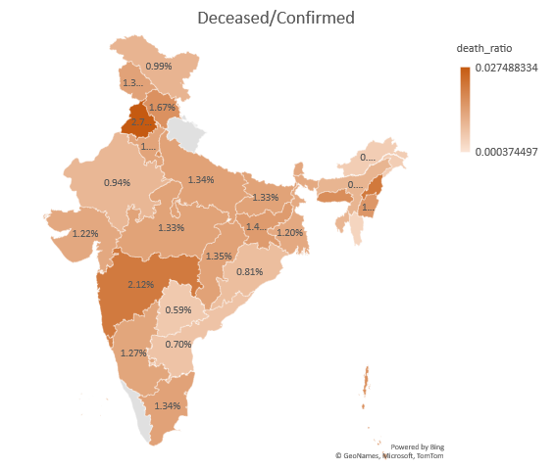
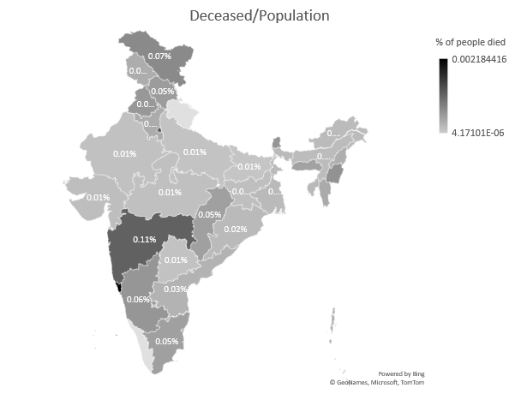
SEVERITY OF CASES IN DIFFERENT STATES
Death Ratio from Confirmed = (Total Deceased / Total Confirmed ) x 100
Punjab,Uttrakhand,Maharashtra has the highest Death Ratio
Dadra and Nagar Haveli,Mizoram,Telegana has least Death Ratio

Slide 10
TESTING RATIO ANALYSIS
Testing ratio(tr) = (number of tests done) / (population)
Category A: 0.05 ≤ tr ≤ 0.1
Category B: 0.1 < tr ≤ 0.3
Category C: 0.3 < tr ≤ 0.5
Category D: 0.5 < tr ≤ 0.75
Category E: 0.75 < tr ≤ 1.0

Slide 11
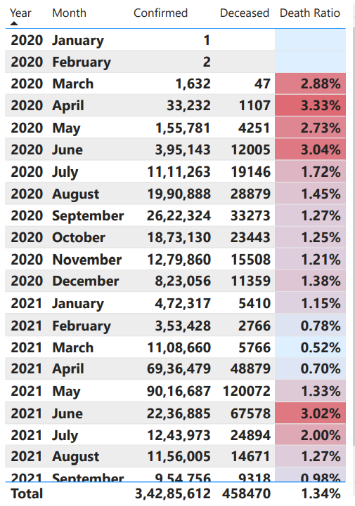
SOME OTHER INSIGHTS
Up and Maharashtra got the highest no of vaccination acc to 7 day moving avg.
West Bengal got the highest no. of 1st dose of vaccination.
In 2021 Delhi showed highest no of recovery case.
Worst hit month: April, may, June in 2020 and June, July in 2021
Category b with testing ratio 0.16 showed largest no. Of deceased person
% Deceased in Delhi is 1.92% more than Bengaluru

Slide 12
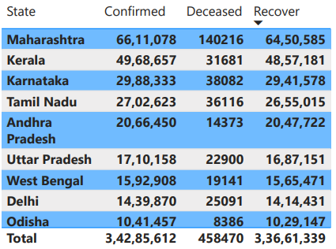
INSIGHTS
MAHARASTRA HAS THE HIGHEST NO. OF CASES BOTH CONFIRMED AND DECEASED.
ANDAMAN AND NICOBAR HAS THE LOWEST NO OF CASES.
MAHARASTRA,KERALA, KARNATAKA, TAMILNADU HAVE THE HIGHEST NO. OF DECEASED AS COMPARED TO OTHER STATE.

Slide 13
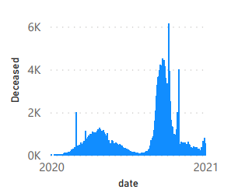
INSIGHTS
On 9th of June there was highest No. Of deceased in the country i.e. 6139 after that we saw declined in the case.
On 20th July there was again sharp rise in the case of deceased.
On may 2021 there were the largest no of test performed in the country.
Between April and may in 2021, the positivity rate was at its peak. i.e. 14% approx. For the previous year the sharpest positivity rate was 9% around month of July in 2020

Slide 14
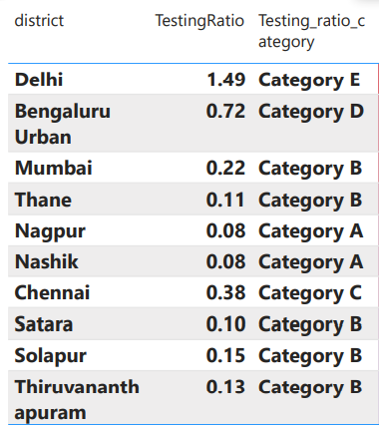
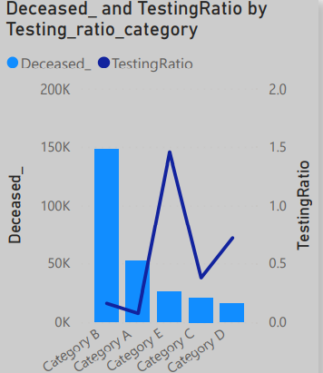
INSIGHTS
Delhi, Bangalore, Mumbai and pane contributed to largest vaccination drive, same case for deceased,
In the month of April every state showed sharpest rise in the case of covid
Most corporate hub district like Mumbai, Bangalore, Pune, showed largest jump in the covid cases.

Slide 15
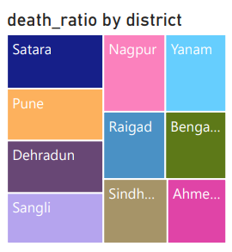
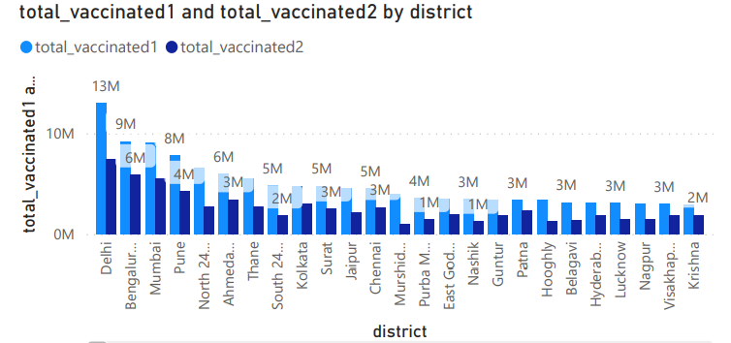
VACCINATED 1 ss VACCINATED 2

Slide 16
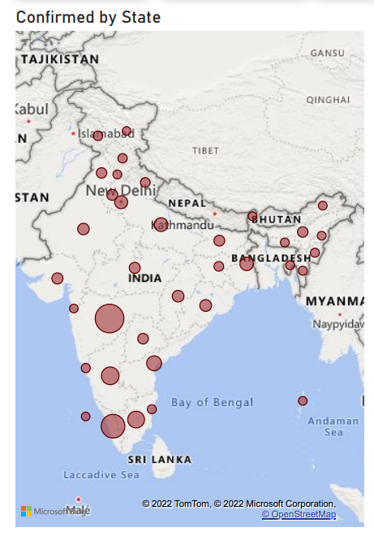
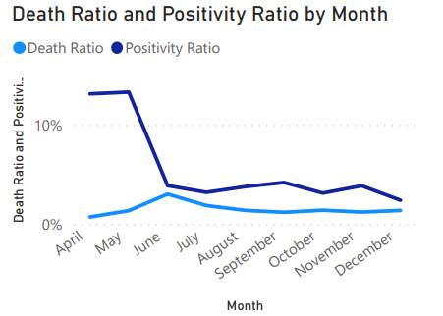
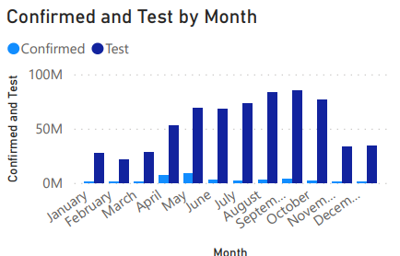
SOME KEY INSIGHTS

Slide 17
LEARNING
How the request module work.
How to convert JSON file into dictionary and data frame.
Better understanding of Pandas Module
How to export the result from SQL in csv format.
How to work in a team
Delegation of task in way to achieve better Productivity

Slide 18
CHALLENGE FACED
How to filter out the data from json file.
How to read the json file and convert Json to dataframe file.
How to convert dataframe to csv .
How to deal with missing data.
How to convert data according to the required data for finding out insights.

Slide 19
REFRENCES
Data Source URLs :
State Data : - https://data.covid19india.org/v4/min/data.min.json
Time Series Data : - https://data.covid19india.org/v4/min/timeseries.min.json
Python Sources Collection File : “python/main.ipynb”
Python Data Cleaning Pipeline file : “python/cleaning.ipynb”
SQL Queries Used File : “sql/sql.txt”
Excel Dashboard : “excel/Basic Dashboard.xslx, Advanced Dashboard”
Sorted Data CSVs : “data/state_data.csv”, “data/timeseries_data.csv”, “data/district_data.csv”

